Slide 1


LOGMASTER AUSTRALIA
Logmaster is an Australian tech company specialising in compliance automation for passenger transport, freight and logistics businesses.

Slide 2
EXECUTIVE SUMMARY
Logmaster is a technology company that specialises in electronic work diary and compliance management systems for the trucking and transport industry in Australia. The Logmaster system is accredited by the National Heavy Vehicle Regulator and is compliant to use Australia wide.
The Logmaster system has been designed to automate and simplify transport safety and compliance. The Logmaster mobile app removes the need to carry a paper work diary and allows operational efficiencies in transmitting driver work and rest information to company record keepers in real-time. The Logmaster mobile app is approved for use on all Android and Apple smartphones and tablets running recent and current operating systems. It has been designed to be the first choice when considering price, value, features, compatibility, additional compliance components and customisation.

Slide 3

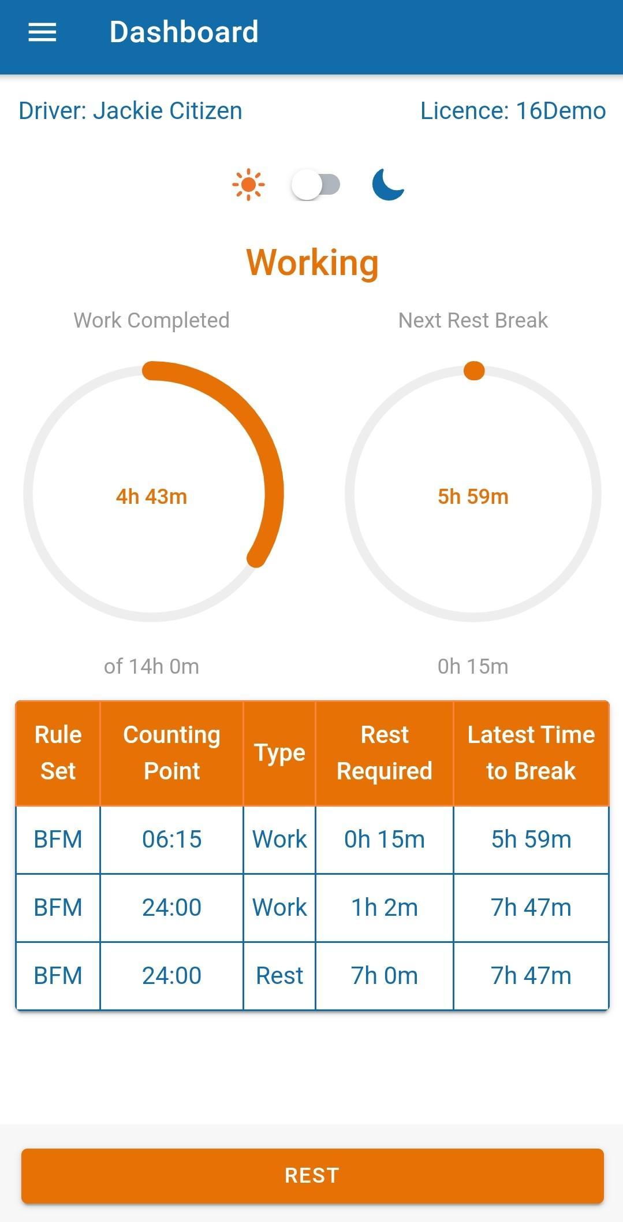
ELECTRONIC WORK DIARY OVERVIEW & FEATURES
ACCESS DRIVER RECORDS
FIT TO DRIVE AND VEHICLE INSPECTIONS
FULL STATISTICS
MANAGE DRIVERS
DEPOT MANAGEMENT
VEHICLE MANAGEMENT

Slide 4
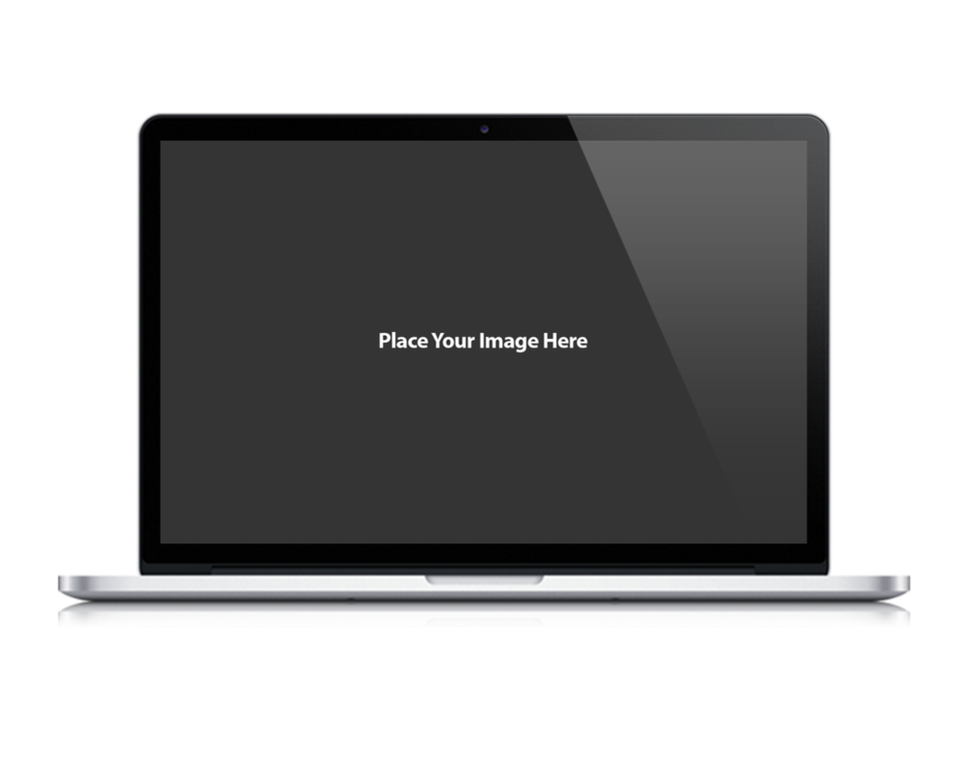
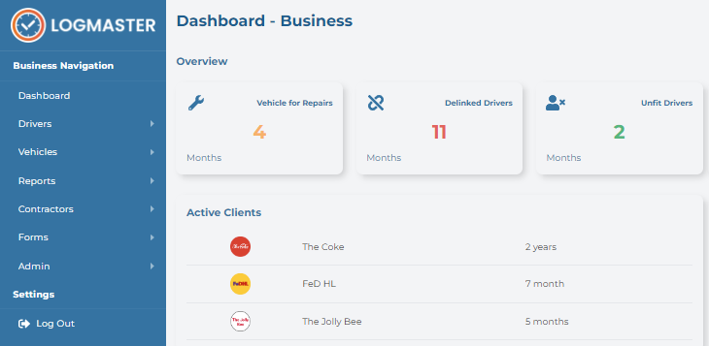
EWD FOR TRANSPORT BUSINESSES
LOGMASTER MANAGEMENT PORTAL
Easily prepare for safety and compliance audits with exportable reports.
Stay up to date with driver licence and vehicle registration renewals with smart expiry alerts.
See real-time data on driver fitness and vehicle pre-start inspection declarations.
Paper work diary log sheets can be entered into the system and checked for breaches.
Fatigue breach alerts for your entire fleet.
Access your record keeper portal securely in the cloud on any device, anywhere, anytime.
Subscription management for ad-hoc drivers, employees and contractors.
The driver depot configuration tools makes it easy for each of your depots to filter out driver and vehicle information that is not relevant to them.

Slide 5

DRIVERS PREFER
LOGMASTER AUSTRALIA MOBILE APP
Log all shift data including start, stop, rest break and finish times.
Geo-tagging provides location data and guarantees accuracy of all records.
Real-time alerts for managing breaks ensures fatigue compliance.
Digital in-app driver fitness declarations and pre-start vehicle inspections appear to the driver at the right moment in the day as part of his work flow. These arrive to the record keeper in real-time and are exportable as PDF.
View your working activity, records and historical data from the app or web portal.
Share your logs and activity with multiple companies.

Slide 6
BENEFITS TO USERS
Increase Accuracy Remove uncertainty around data collection with real time input and updates. Geo tagging, shift duration logging and licence renewal reminders means you’ll always have accurate records. | Deploy and Install Drivers download the Logmaster Australia app from Google Play store and Apple App store and connect with your business. Logmaster does not require you to use specific equipment to stay compliant.
Eliminate Paperwork Switch from written work diaries that need to be delivered to the office, to Logmaster where all driver work and rest information is sent directly through to the record keeper. Mandatory driver fitness declarations and vehicle pre-start checklists are digitised to further remove the need for paperwork. | Feature Rich Logmaster offers additional features to make your EWD system even more beneficial to drivers and record keepers. Manual paper log entry, user depot structure configuration, driver statistics, fraud protection, record keeper alerts and out of coverage usability are just a few of the many improvements included in Logmaster EWD.

Slide 7
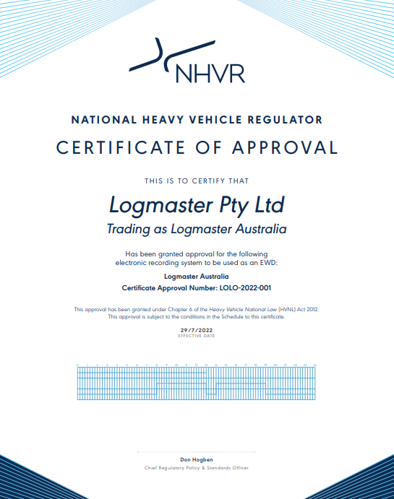
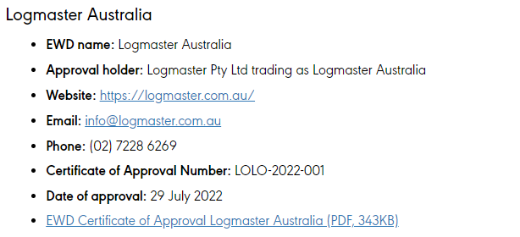
NHVR ACCREDITATION

